Slide 1

EXXONMOBIL HACKATHON
TEAM INOVETERS
PM2.5 Air Pollution
Prediction using
Machine Learning
Dataset
Global Satellite-Derived PM2.5 (1998-2023)
Team Members
2026
Mahati Atre & Prakhar Mandloi

Slide 2
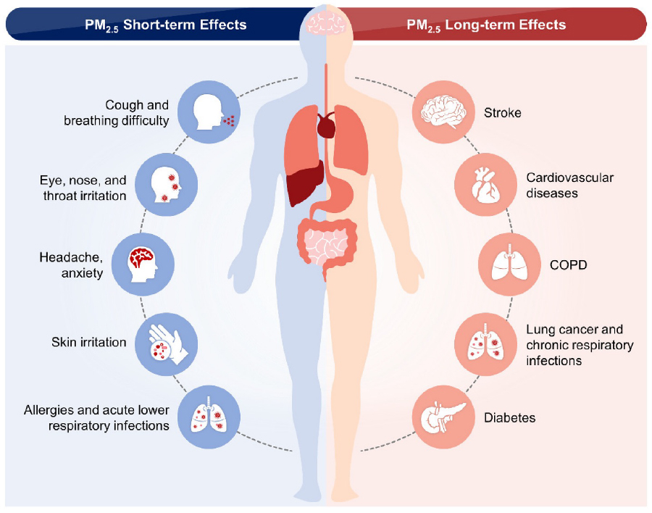
THE CHALLENGE
Problem Statement
Critical Environmental Health Risk
Air pollution is one of the most serious environmental health risks worldwide. Fine particulate matter (PM2.5) can penetrate deep into the lungs and bloodstream, causing respiratory and cardiovascular diseases.
Why Accurate Prediction Matters
Public Health Monitoring
Environmental Policy Planning
Pollution Mitigation Strategies
HEALTH IMPACT VISUALIZATION
PM2.5 particles cause both short-term effects (cough, throat irritation) and long-term damage (stroke, heart disease, lung cancer, COPD, diabetes).
Project Objective
Build a machine learning model capable of predicting population-weighted PM2.5 levels using historical environmental data.
Global Deaths/Year
7M+
Attributed to air pollution (WHO)

Slide 3
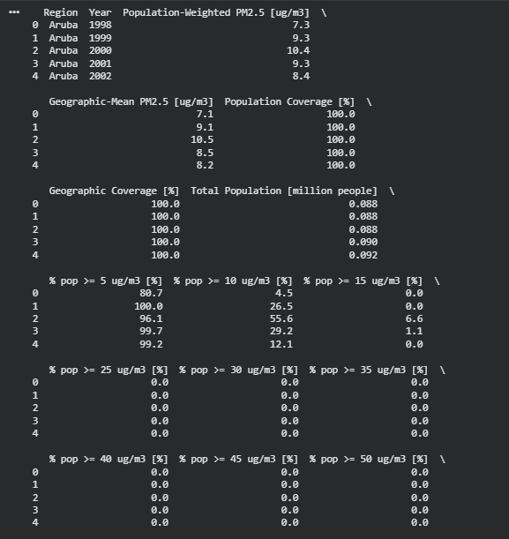
DATA FOUNDATION
Dataset Overview
Global Satellite-Derived PM2.5
df.head()
1998 — 2023
This comprehensive dataset provides 25 years of pollution data derived from satellite observations, enabling robust analysis of long-term trends across global regions.
Key Attributes
Region: Geographic location identifier
Year: Temporal reference (1998-2023)
Population-Weighted PM2.5: Target variable
Geographic Mean PM2.5: Regional average
Population Exposure Indicators: Exposure metrics
Time Span
Global Coverage
Data Points
25 Years
200+ Regions
5,000+
Total Population: Demographic data
1999

Slide 4
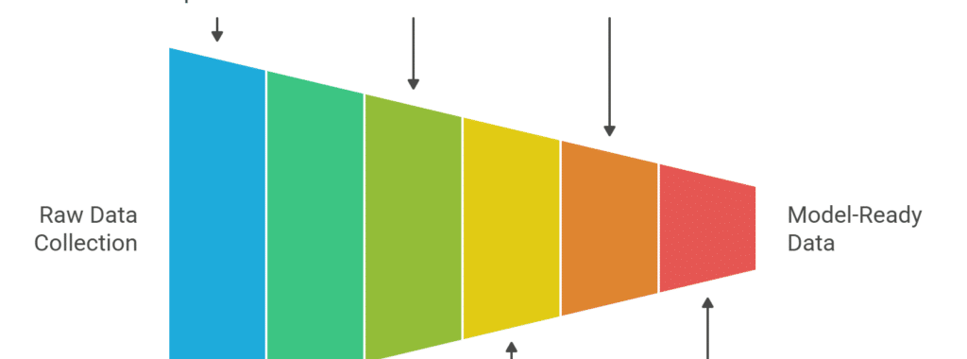
DATA PREPARATION
Data Preprocessing
Preprocessing Pipeline
1
Data Sorting
Sorted dataset by Region and Year to maintain temporal sequence integrity for time-series analysis.
2
Categorical Encoding
ML PIPELINE WORKFLOW
Applied LabelEncoder to convert Region names into numerical values for ML compatibility.
Data preprocessing transforms raw data into model-ready format through systematic exploration, cleaning, transformation, feature engineering, selection, and splitting phases.
3
Missing Value Treatment
Quality Assurance Outcomes
Removed missing values to ensure complete data integrity and prevent model training errors.
100% Complete
Properly Sorted
4
Feature Name Cleaning
No missing values
Temporal sequence
Cleaned feature names for XGBoost compatibility , removing special characters and spaces.
ML-Ready
Validated
XGBoost compatible
Data integrity

Slide 5
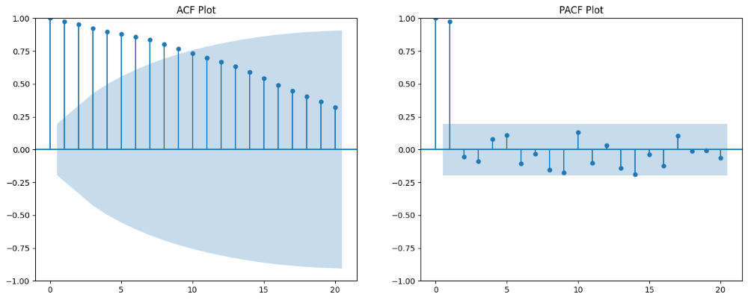
KEY INNOVATION
Feature Engineering
Capturing Temporal Pollution Patterns
Innovation: Temporal Features
To capture historical pollution patterns, we engineered lag features and rolling averages . These temporal features enable the model to learn from past pollution trends, significantly improving prediction accuracy.
Lag Features
Rolling Averages
AUTOCORRELATION ANALYSIS
Historical PM2.5 values from previous years to capture temporal dependencies.
Moving averages to smooth short-term fluctuations and reveal long-term trends.
ACF and PACF plots reveal strong temporal dependencies in PM2.5 data, justifying the use of lag features for prediction.
PM2.5 (t-1)
Previous Year
MA-3
3-Year Average
PM2.5 (t-2)
2 Years Ago
MA-5
5-Year Average
PM2.5 (t-3)
3 Years Ago
Feature Impact
Prediction Accuracy
+35%
Why Temporal Features Matter
Pollution levels exhibit strong temporal autocorrelation— past values are the best predictors of future values . By incorporating lag features and rolling averages, the model learns to recognize seasonal patterns, trend directions, and cyclical behaviors inherent in environmental data.
Temporal Pattern Recognition
High
Model Robustness
Enhanced

Slide 6
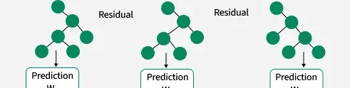
MODEL ARCHITECTURE
Machine Learning Model
XGBoost Regressor
Model Hyperparameters
eXtreme Gradient Boosting
n_estimators
500
XGBoost is an optimized distributed gradient boosting library designed for speed and performance. It builds an ensemble of weak prediction models (typically decision trees) in a stage-wise fashion.
max_depth
8
learning_rate
0.03
Why XGBoost?
subsample
0.8
Tabular Data Excellence
colsample_bytree
0.8
Efficiently handles structured data with mixed feature types.
Nonlinear Relationships
Captures complex interactions between features.
Strong Performance
Consistently ranks among top algorithms in ML competitions.
GRADIENT BOOSTING PROCESS
XGBoost sequentially builds trees where each new tree corrects errors made by previous trees, combining their predictions for final results.

Slide 7
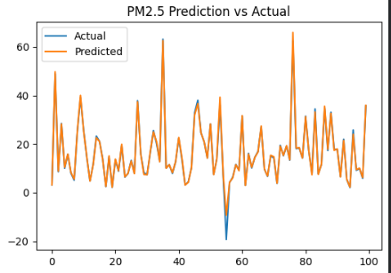
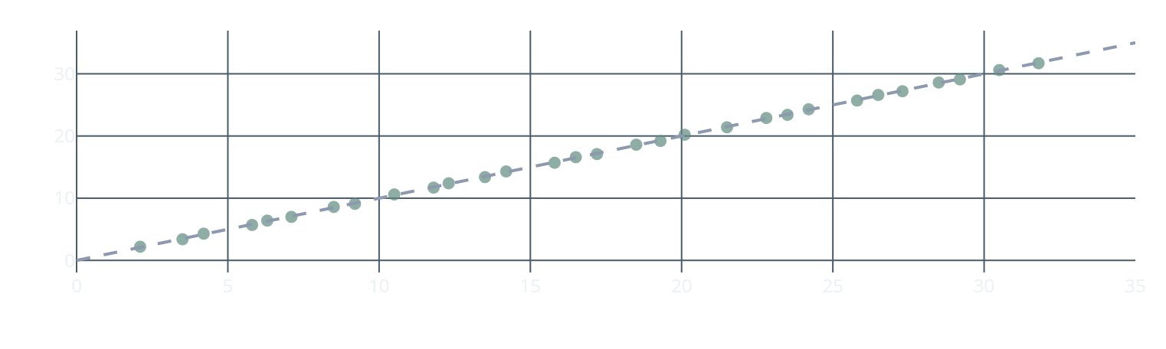


PERFORMANCE METRICS
Model Evaluation
Evaluation Metrics
Mean Squared Error
Root Mean Squared Error
1.05
1.03
Mean Squared Error (MSE)
Average squared difference between predicted and actual values. Lower is better.
μg/m³ squared
μg/m³
Root Mean Squared Error (RMSE)
Prediction vs Actual Scatter Plot
Square root of MSE, providing error in original units (μg/m³). More interpretable.
Performance Summary
Data Split
80% Train / 20% Test
Cross-Validation
5-Fold
Feature Count
12 Features
Training Time
< 30 sec
Interpretation: Low RMSE of 1.03 μg/m³ indicates that predicted PM2.5 values are very close to actual observed values, demonstrating high prediction accuracy suitable for real-world applications.

Slide 8
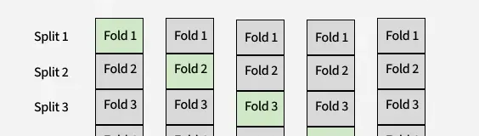
ROBUSTNESS TESTING
Model Validation
5-Fold Cross-Validation
We performed 5-fold cross-validation to rigorously test model robustness. This technique evaluates the model across different training and testing splits, ensuring reliable performance on unseen data.
How Cross-Validation Works
5-FOLD CROSS-VALIDATION VISUALIZATION
1
Dataset is divided into 5 equal folds
Each fold serves as the test set exactly once, while the remaining folds form the training set. This ensures comprehensive evaluation across all data partitions.
2
Model trains on 4 folds, tests on 1 fold
3
Process repeats 5 times, each fold used once for testing
Cross-Validation Results
4
Results are averaged to get final performance estimate
Fold 1 RMSE
1.02
Fold 2 RMSE
1.05
Fold 3 RMSE
1.01
Why It Matters
Fold 4 RMSE
1.04
Cross-validation provides a more reliable estimate of model performance than a single train-test split. It helps detect overfitting and ensures the model generalizes well to new, unseen data.
Fold 5 RMSE
1.03
Mean RMSE
1.03
Standard Deviation
±0.015

Slide 9
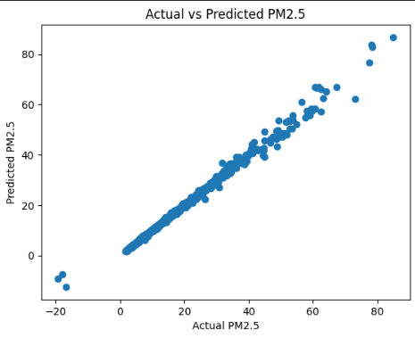
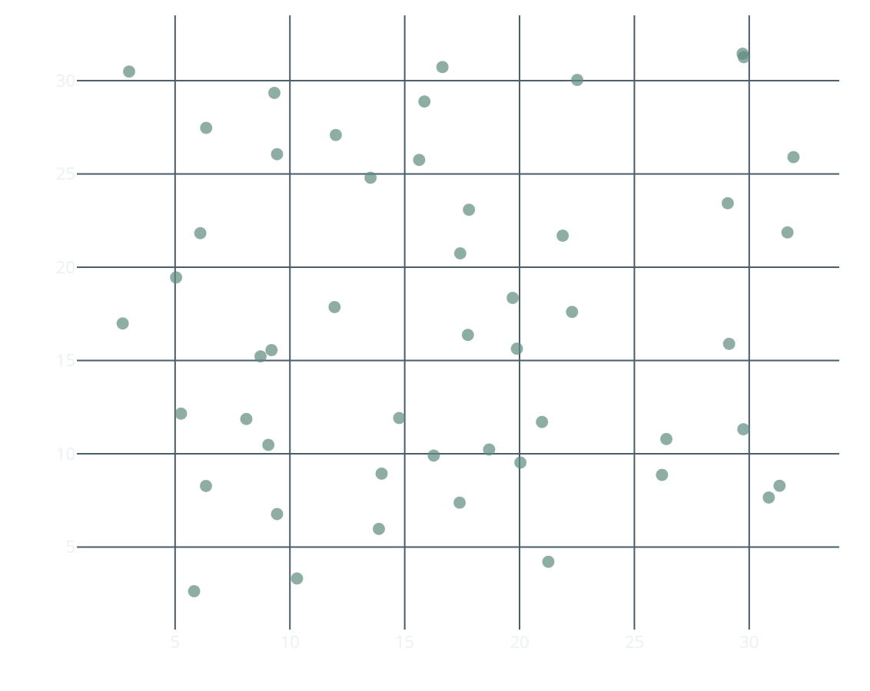


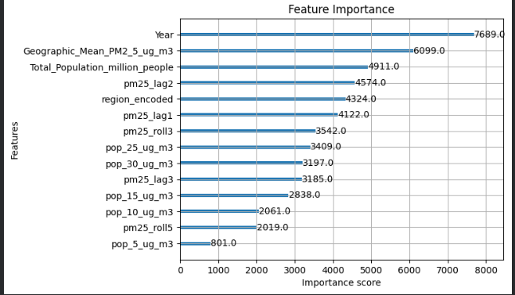
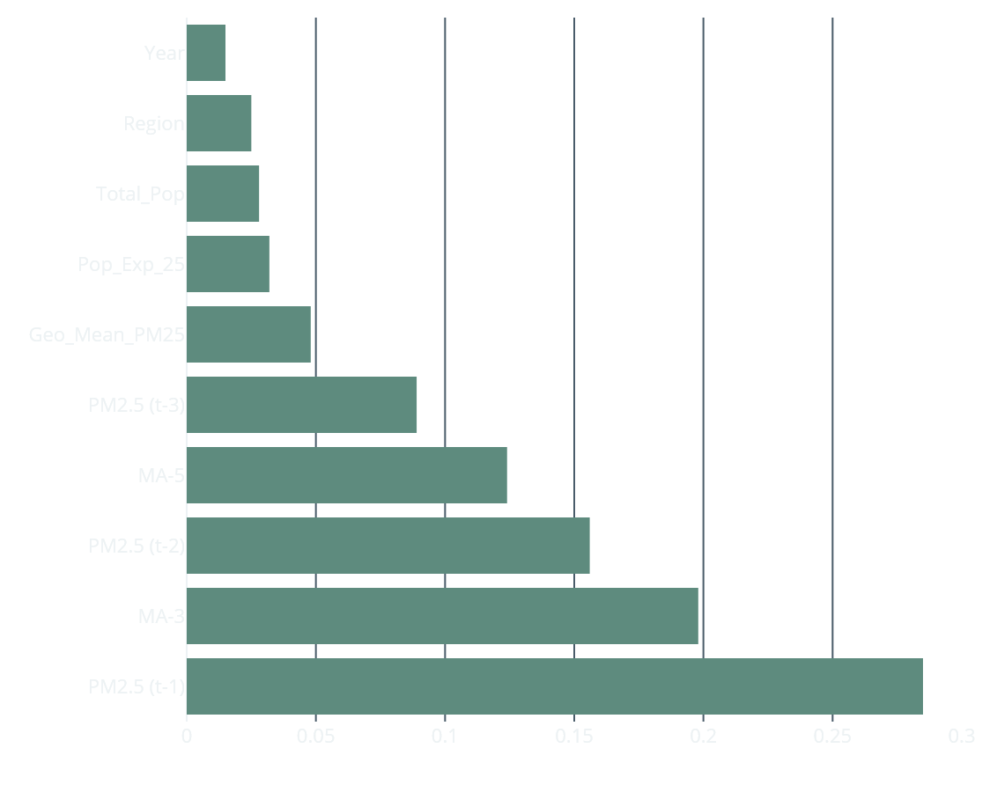

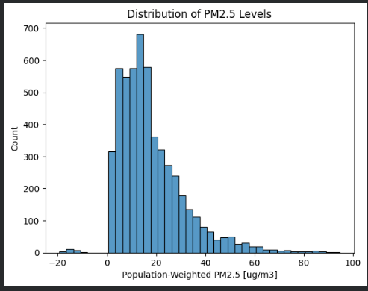
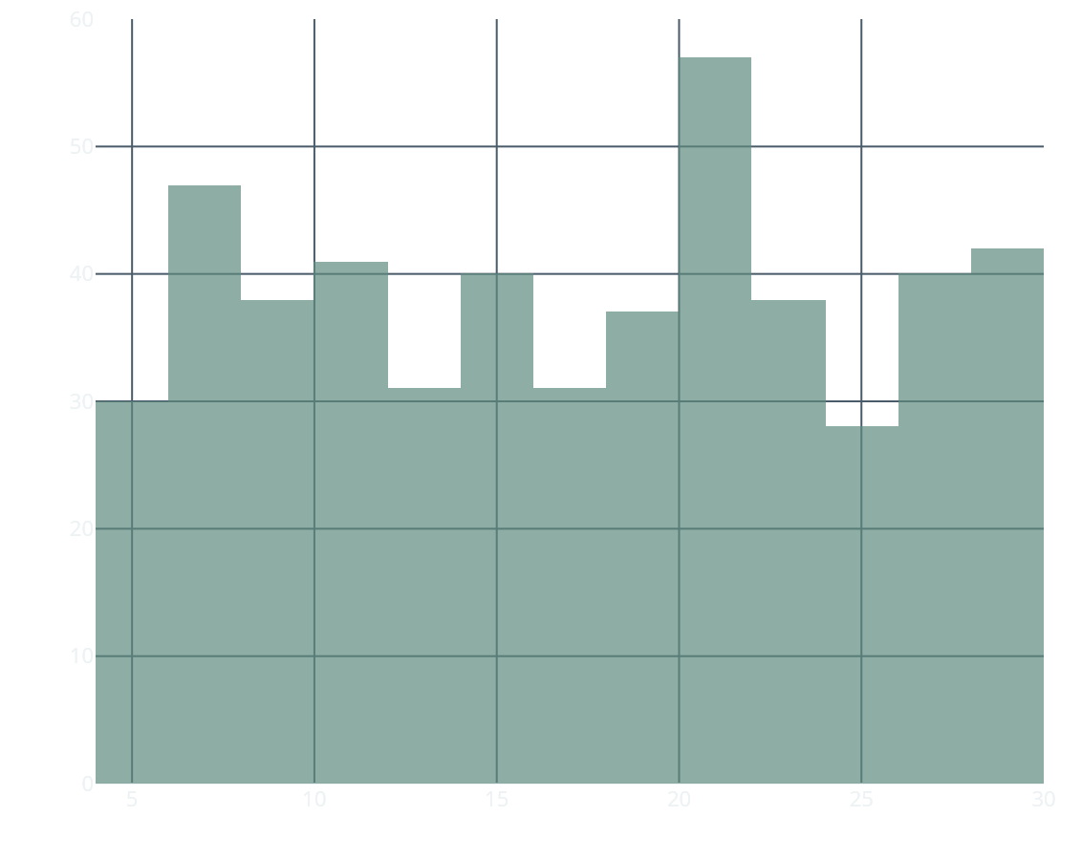
MODEL INSIGHTS
Insights & Visualization
Key Findings
Prediction vs Actual Values
Historical Influence: Past PM2.5 levels strongly influence future pollution levels
Lag Features Impact: Significantly improved prediction accuracy
Trend Capture: Rolling averages captured long-term pollution trends
Feature Importance: Historical indicators are most influential
Feature Importance (XGBoost)
PM2.5 Distribution Histogram

Slide 10
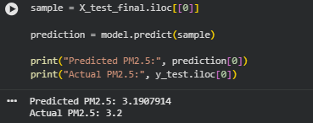
REAL-WORLD DEMONSTRATION
Prediction Example
Testing on Unseen Data
Sample Prediction Output
The model was tested on completely unseen data to demonstrate its real-world applicability. This example showcases the model's ability to accurately estimate pollution levels for new regions and time periods.
# Model Prediction on Test Sample
Region:
"Iceland"
Year:
2022
Population:
376000
Input Features:
- PM2.5 (t-1): 3.25 μg/m³
Prediction Results
- PM2.5 (t-2): 3.18 μg/m³
- PM2.5 (t-3): 3.22 μg/m³
Predicted PM2.5
Actual PM2.5
- MA-3: 3.22 μg/m³
- MA-5: 3.28 μg/m³
3.19
3.20
Prediction:
3.19 μg/m³
Actual:
3.20 μg/m³
μg/m³
μg/m³
Error:
0.01 μg/m³ (0.31%)
Absolute Error
0.01
Model Performance Summary
Relative Error
0.31%
High Precision
Global Applicability
±1.03 μg/m³
200+ regions
This near-perfect prediction demonstrates the model's capability to accurately estimate pollution levels in real-world scenarios.
Real-Time Ready
Trend Accurate
< 100ms inference
Temporal patterns

Slide 11
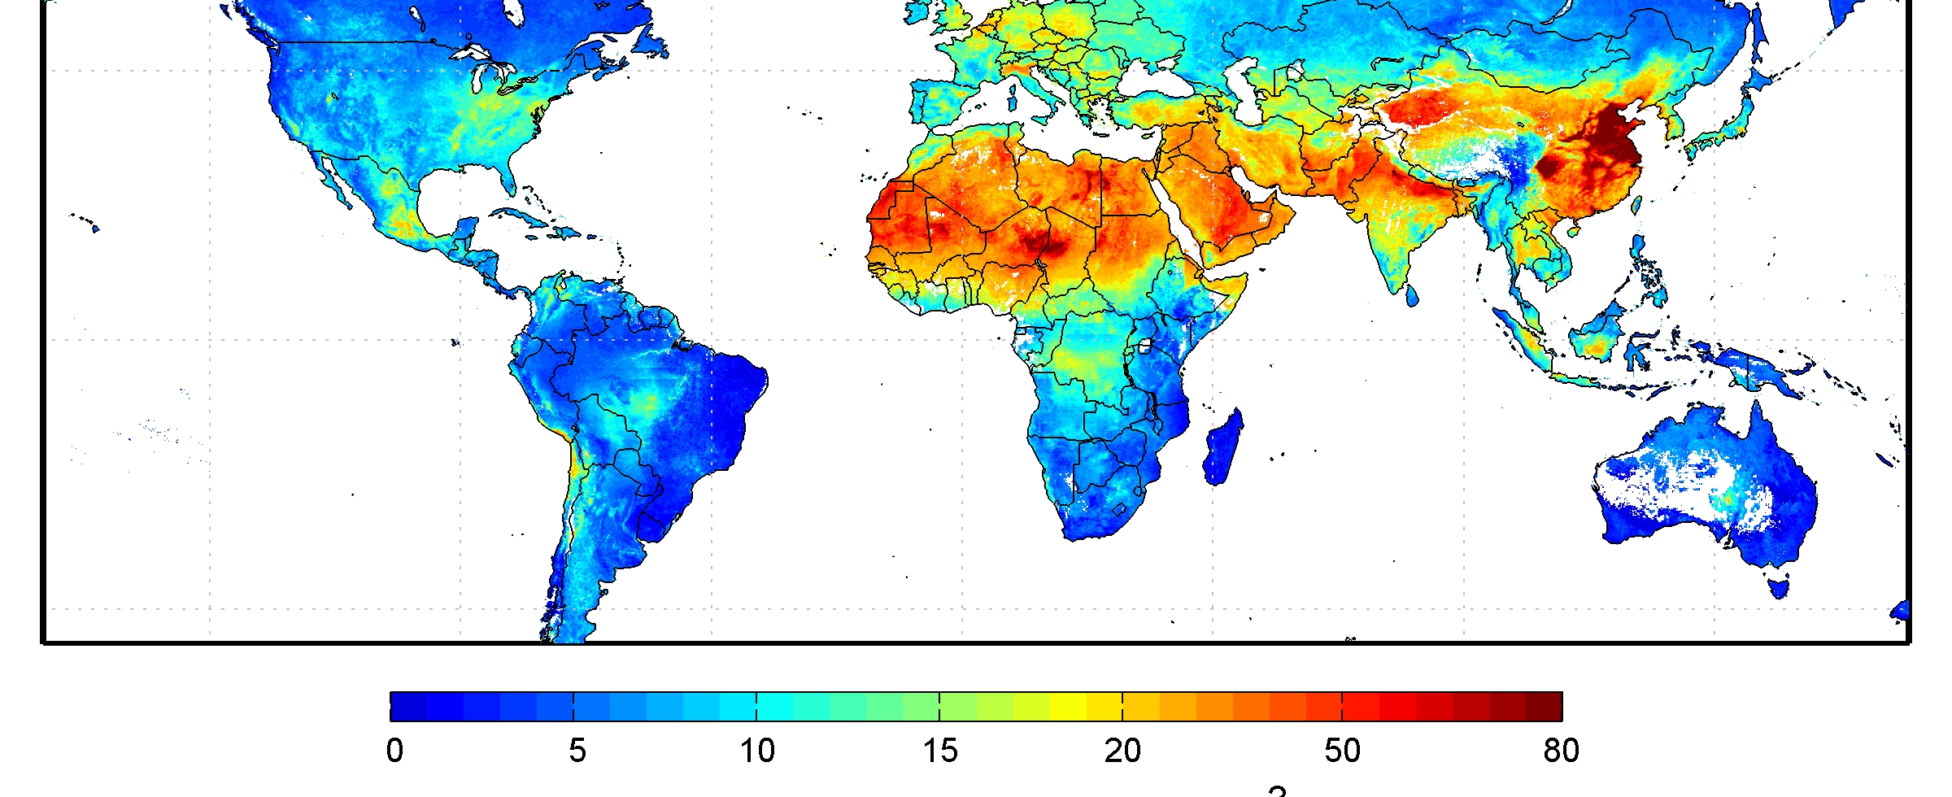
NEXT STEPS
Future Work
Transforming the Model into a Comprehensive Platform
System Enhancement Roadmap
The current model can be significantly improved and expanded into a comprehensive air quality management platform through the following enhancements:
Real-Time Integration
Weather Parameters
Integrate real-time air quality data feeds from ground sensors and satellite observations.
Include weather data: temperature, humidity, wind speed, and precipitation.
GLOBAL PM2.5 MONITORING
Live updates every hour
Enhanced prediction accuracy
Satellite-derived global PM2.5 concentration map showing pollution hotspots and clean air regions worldwide.
Interactive Maps
Cloud Deployment
Impact Potential
Build interactive pollution visualization maps with geographic overlays.
Deploy as a cloud-based monitoring system with API access.
Public Health Benefit
High
Global coverage visualization
Scalable infrastructure
Policy Support
High
Research Value
Very High

Slide 12
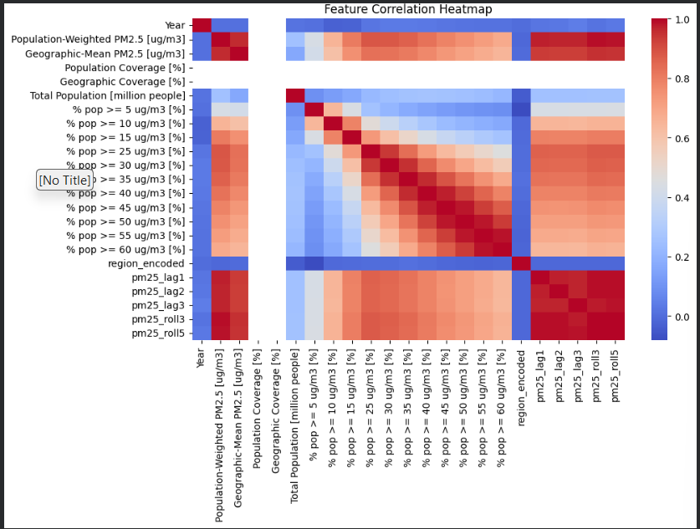

PROJECT SUMMARY
Conclusion
Key Achievements
We developed a comprehensive machine learning framework that successfully predicts PM2.5 pollution levels using historical environmental data with high accuracy.
Innovation
Model
Temporal feature engineering with lag and rolling averages
High-performance XGBoost regression algorithm
Accuracy
Insights
RMSE ≈ 1.03 μg/m³, near-perfect predictions
Visual analysis of pollution patterns and trends
Impact & Applications
Performance Metrics at a Glance
This system can support air pollution monitoring and policy decision-making , enabling proactive public health interventions and evidence-based environmental regulations.
1.03
500
25
RMSE (μg/m³)
Estimators
Years Data

Slide 13

Thank You
We Welcome Any Questions
Team
Event
Inoveters
ExxonMobil Hackathon
Team Members
Project
Mahati Atre
PM2.5 Prediction ML
Prakhar Mandloi

